Slide 1

FACBLOX: A Proof of Concept of an Industrial Metaverse using Roblox

Slide 2
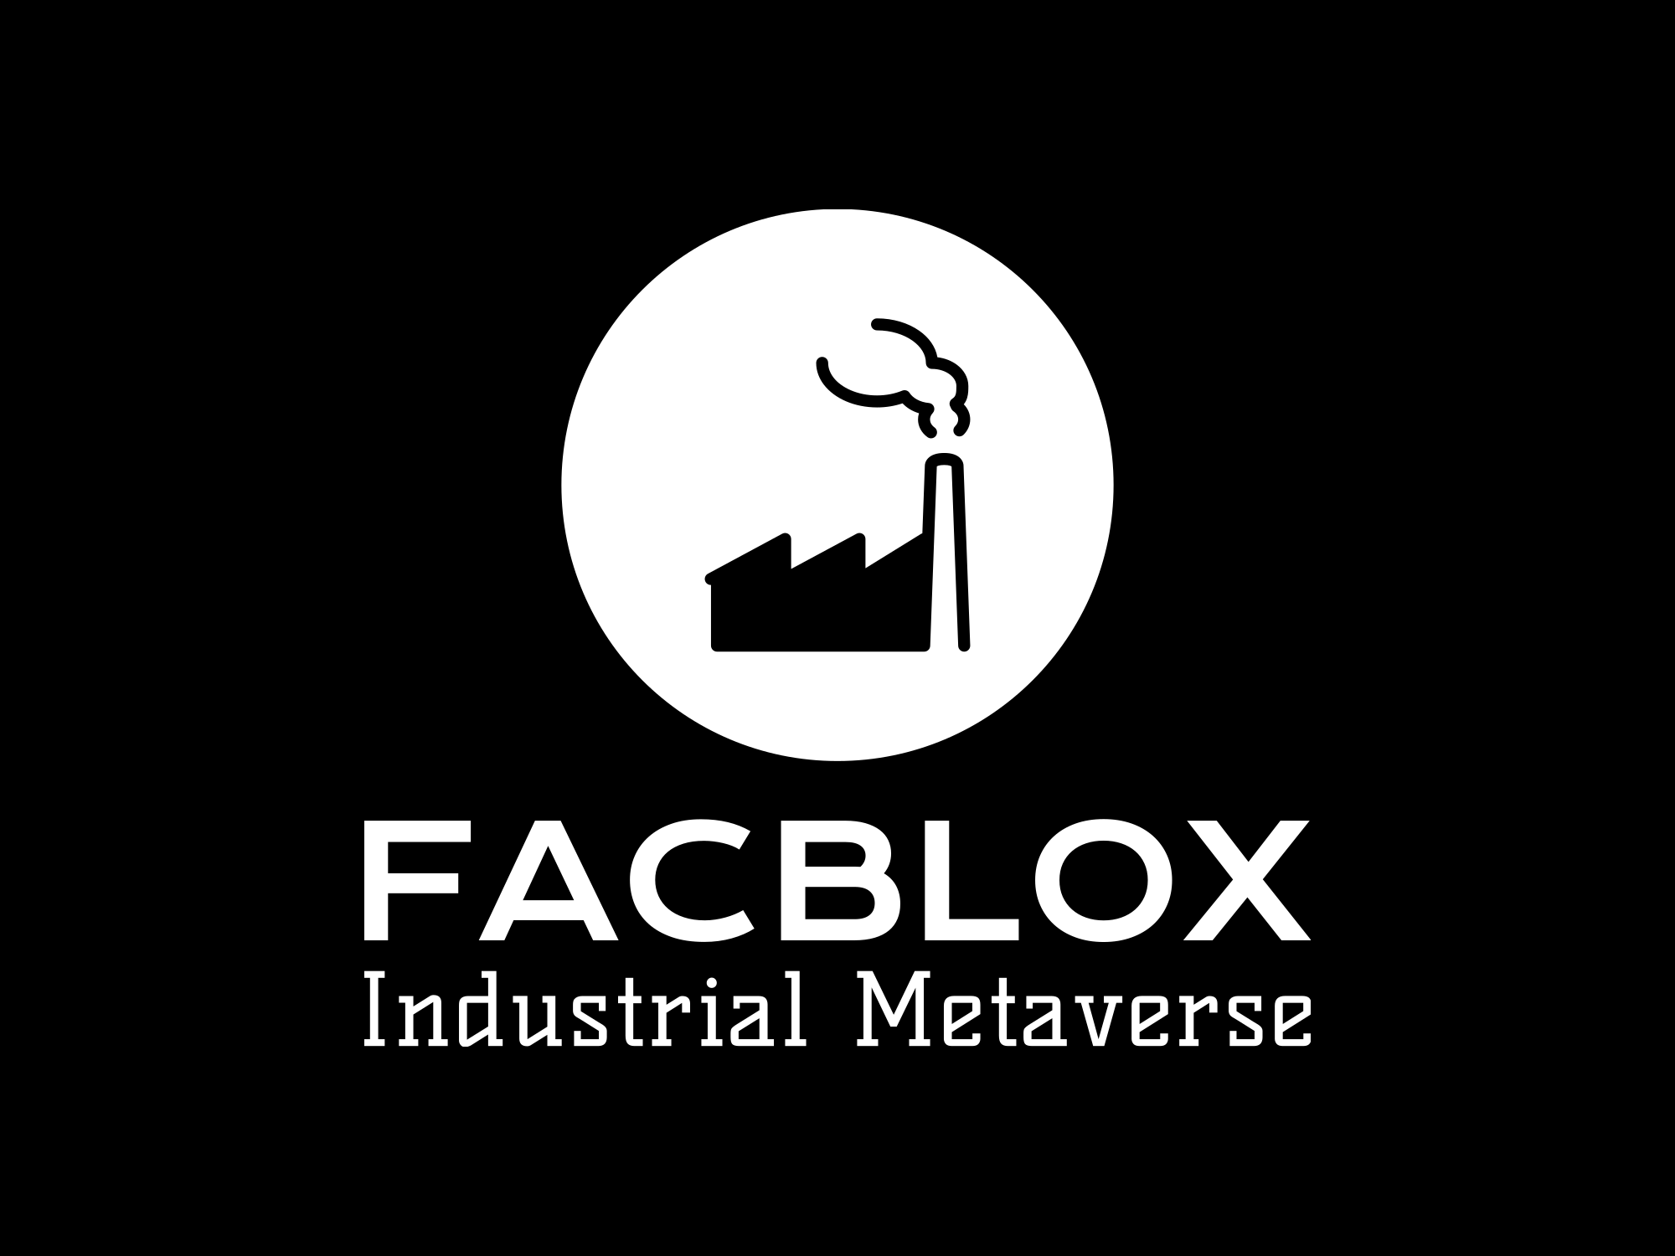
Agenda
01
Introduction
02
Proof of Concept
03
Integration
04
Potential Applications
05
Conclusion

Slide 3
Introduction

Slide 4
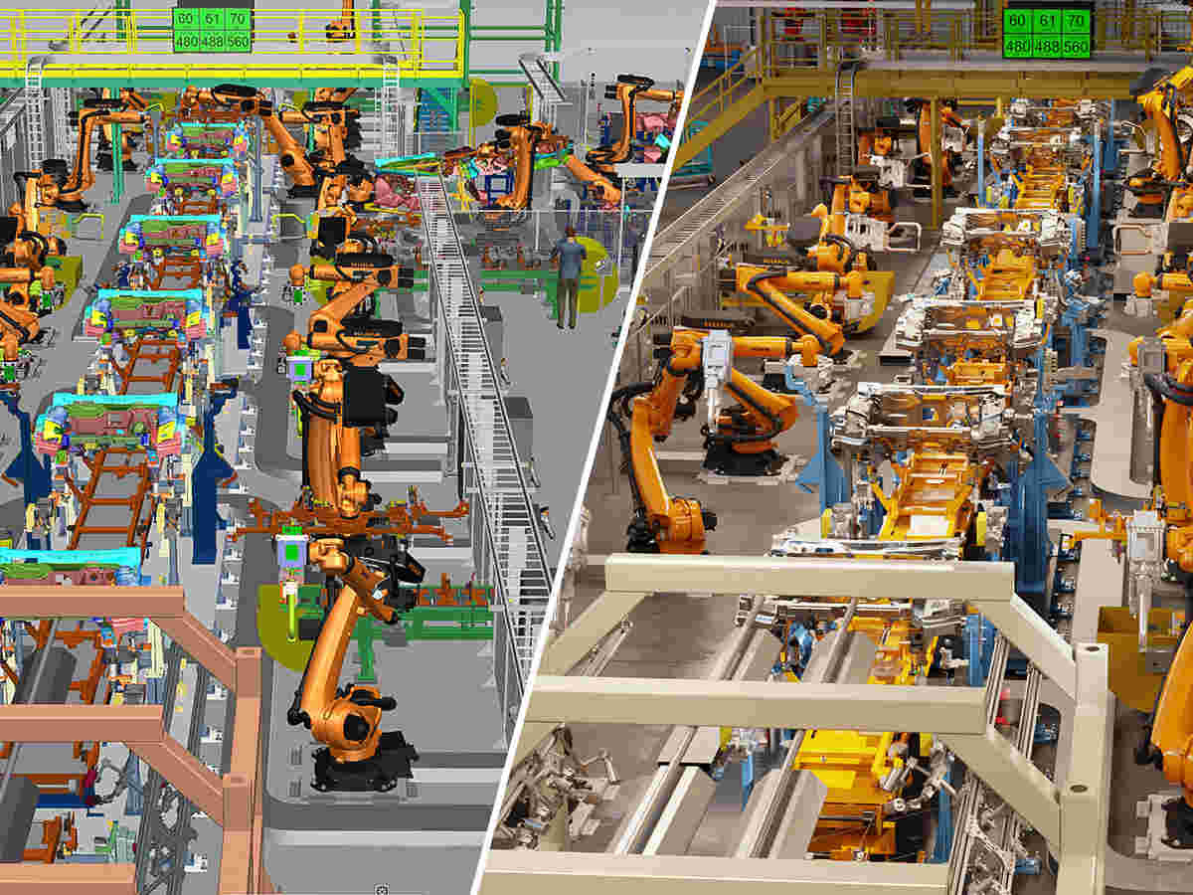
Introduction
Exploring industrial metaverse
Background
Industrial metaverse
Poised to transform
Value for businesses
Figure: Industrial Metaverse. Image retrieved from Siemens.

Slide 5
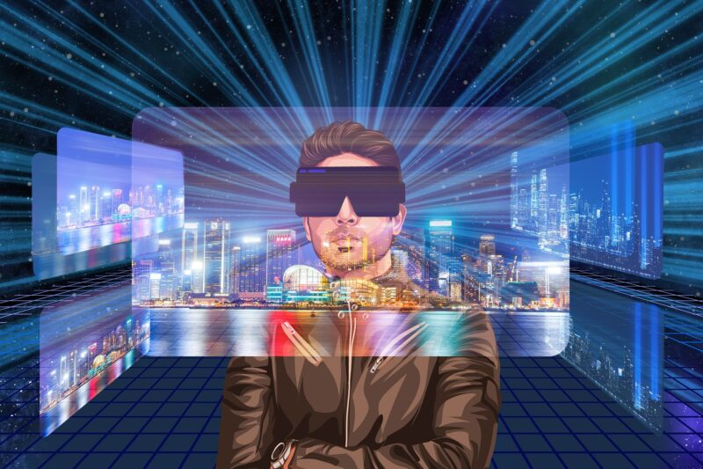
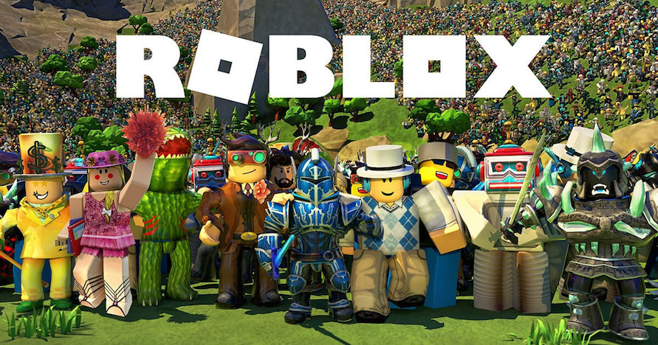
Introduction
Exploring industrial metaverse
Transition to the proof of concept
Goal
Purpose-built industrial metaverse
Roblox

Slide 6
Proof of Concept

Slide 7
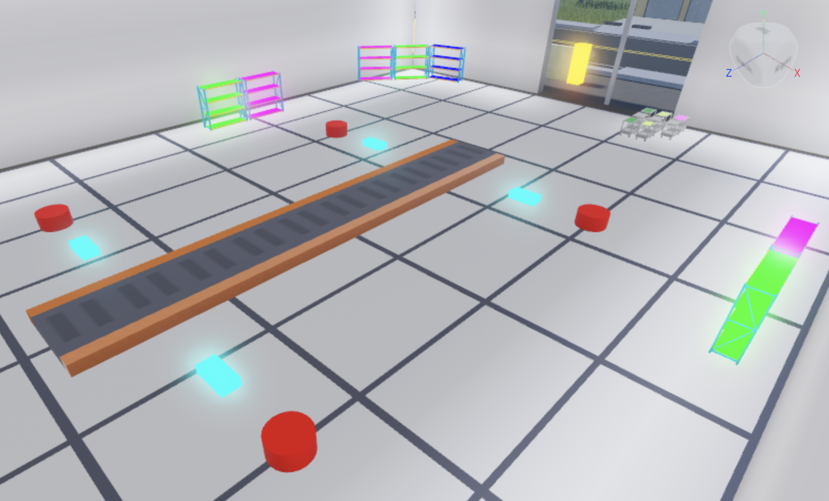
Proof of Concept
Building a factory simulation in Roblox
FACBLOX
POC replicates real-world systems within a virtual factory environment
Featuring transporters and workstations
Roblox game and the backend
Link: https://www.roblox.com/games/15946822173/Factory-V5

Slide 8
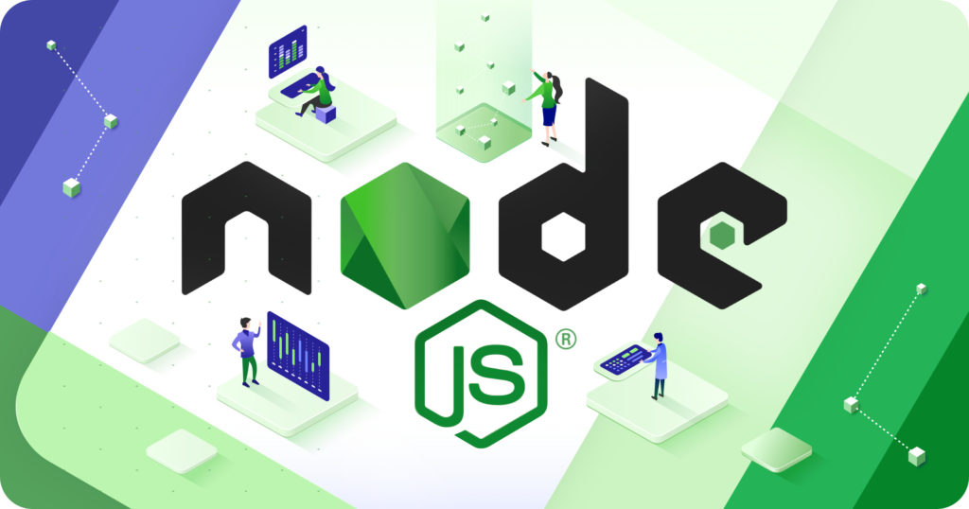

Proof of Concept
Building a factory simulation in Roblox
Backend development
Node.js and Express
State management
Deployed to a server
This Photo by Unknown Author is licensed under CC BY-SA-NC
This Photo by Unknown Author is licensed under CC BY-SA

Slide 9
Integration

Slide 10
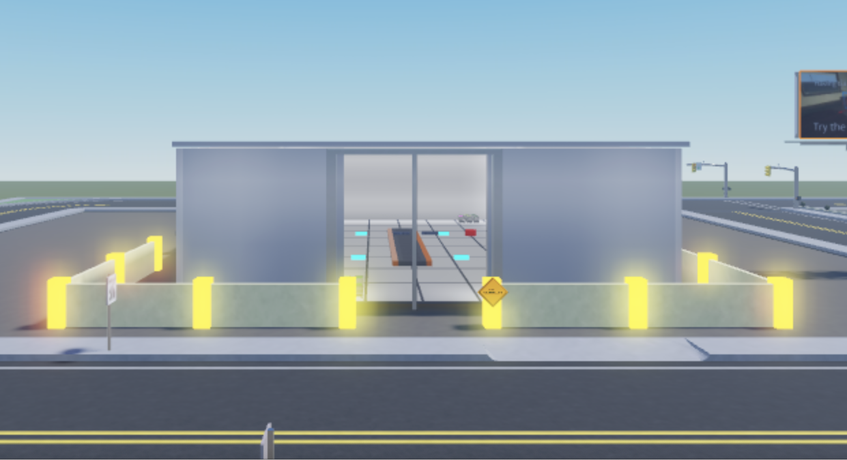
Integration
Bridging the virtual and real worlds
Description
Integrated the Roblox game with the backend system
Established communication: HTTP requests
CRUD requests for synchronization

Slide 11
Potential Applications

Slide 12
Potential Applications
Industrial Metaverse in the the Roblox
Application
Utilize POC
Create real-world manufacturing factories in Roblox
Advantages of the Roblox
Open-source
Free accessibility
Large community
Easy
Rrealistic applications

Slide 13
Conclusion

Slide 14
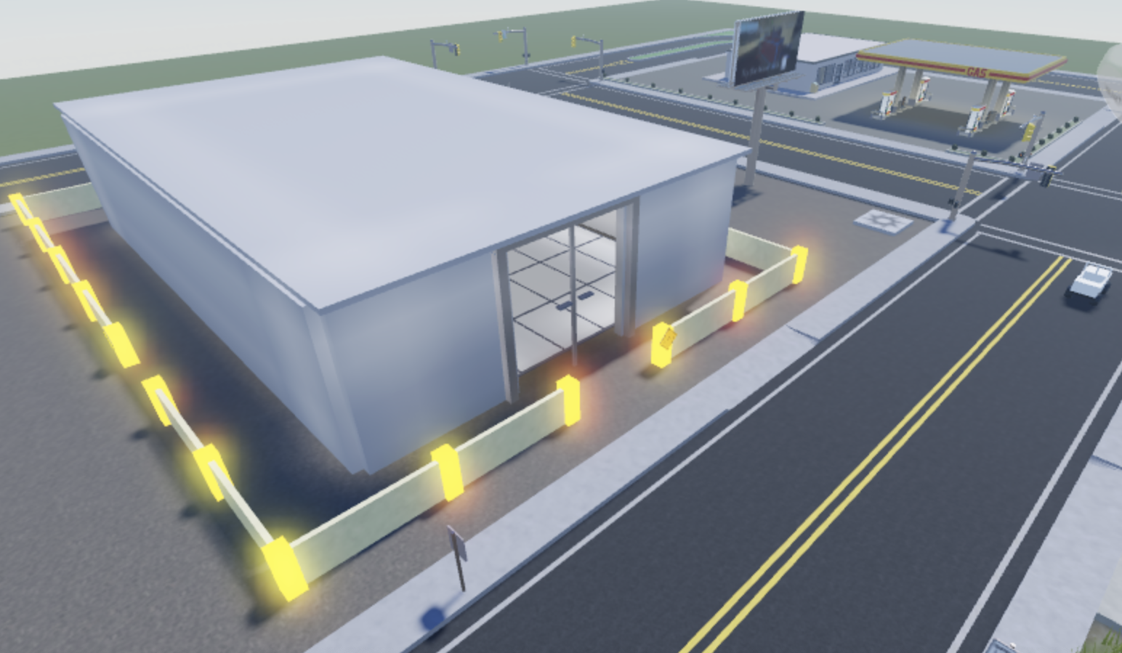
Conclusion
Unlocking possibilities
Summary
Laying the groundwork
Potential of industrial metaverse
Roblox: Advantages and opportunities
Summer Forest

Slide 15
Thank You

